Slide 1
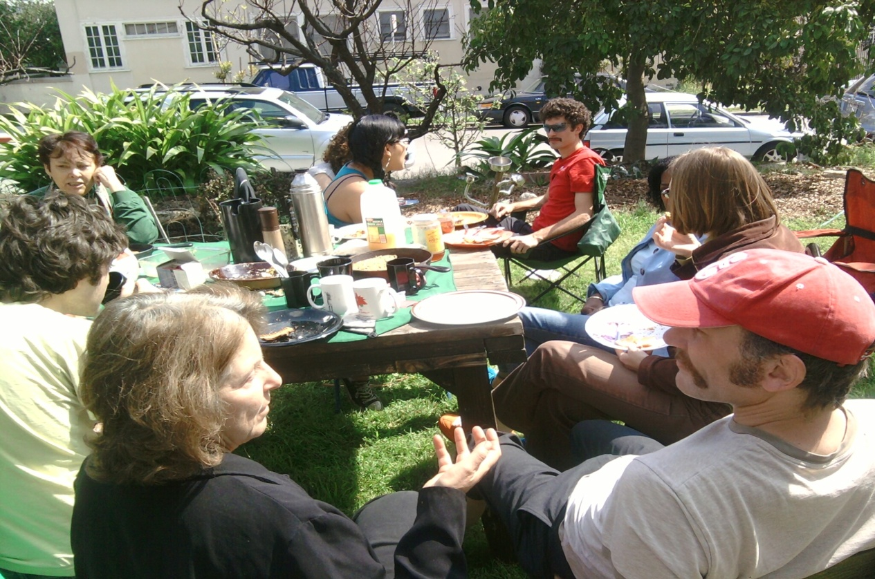
Liaison 101

Slide 2
What is a Liaison?
A primary point of contact between an applicant and the community.
On behalf of the community, the liaison is available to answer the applicant's questions and keeps informed about the interest and intention of the applicant.
The liaison works with the applicant through all the steps of the process until full membership, unless either party requests a reassignment.
Complete Liaison Guidelines can be located here

Slide 3
What Should I Do in the Interested Phase?
Go over the checklist for the membership process
Be the go-to person when members have any concerns about the liaisee
Facilitate discussions between liaisee and members to address any concerns.
Have a conversation in person or over the phone about the liaisee's readiness and participation level in USTU's iniatives and committees before scheduling green light interview.
If there is an agreement on readiness, schedule a greenlight interview (this is a 2 step process).

Slide 4
What Should I Do in the Candidacy Phase?
Continue to facilitate discussions between the liaisee and members with concerns
Invite liaisees to the monthly neighborhood potlucks¹ to meet other members.
Encourage them to continue participating in any of USTU’s initiatives and committees
If there is an agreement on readiness between the liaision and liaisee, schedule a provisional membership interview (3 step process).

Slide 5
What Should I do When My Liaisee is a Provisional Member?
Liaisees will now take initiative on their 3 month check-in and full membership interview, but liaisons can engage with liaisees if they neglect to do so in a timely manner.
Continue to facilitate discussions between liaisee and other members with concerns
Since this phase requires less responsibilities from the liaision, USTU members can be liaisions to a provisional member and another liaisee simultaneously

Slide 6
Updates
Click here for the full list of those in the membership process
Scheduling full membership interviews
Jordan Balagot: prov. member on 10/27/14
Daniel Knoll: prov. member on 02/01/15
Bruce Dobbs: prov. member on 03/16/15 (eligible after Sept 21)
Scheduling provisional membership interviews
Jess Ruvalcaba: greenlit on 3/23/15 (scheduled for Aug 17)
Shakti Murthy: greenlit on 5/18/15
Anaisabal Mercado: greenlit on 6/15/15 (eligible after Aug 10)
Roberta Morris: greenlit on 07/27/15 (eligible after Sept 28)

Slide 7
Reminder
Neighborhood Potluck on Sunday, August 30th
^{5pm: USTU} ^{membership orientation}
^{6pm: Neighborhood potluck}
7:30pm: Screen Exit Through the Gift Shop
^{Notes}
Please invite liaisees, friends, and family.
^{Liaisions, please inform} liaisees about the orientation if they haven’t attended one yet.
Members are highly encouraged to attend to get to know liaisees
Vegetarian dishes are encouraged
Need volunteers for set up and clean up

Slide 8
Questions and Feedback

